Slide 1
Contextual Bandits in a Collaborative Environment
Qingyun Wu¹, Huazheng Wang¹, Quanquan Gu², Hongning Wang¹
¹Department of Computer Science
²Department of Systems & Information Engineering
University of Virginia

Slide 2

Running Example: News Recommendation
Exploitation-Exploration dilemma:
Focus on information that raises user interest
Explore new information to improve user experience in the long run
Notes:
First let’s start from the application of news recommendation.
In the application of news recommendation, the system present news to the users and users provide response to the recommendation: either click or not.
An intelligent system will update the future recommendation based on users’ response.
If we think about this problem, we may find that there is a exploitation-exploration dilemma for the system.
On one hand, the system need to focus on information that raises user interest
On the other hand, the system need to explore new information to improve user experience in the long run

Slide 3
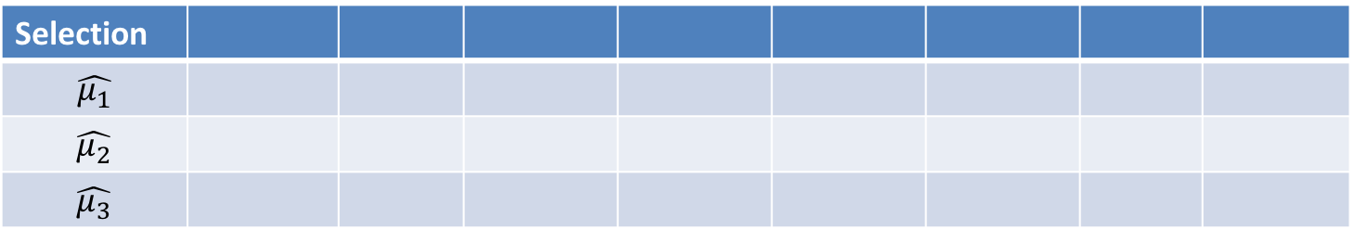
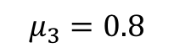
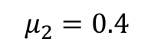
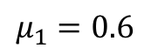
Exploitation VS. Exploration
Find some icon to make these three different, we should reduce such unnecessary confusion
$$μ_{1}=0.6$$
$$μ_{2}=0.4$$
$$μ_{3}=0.8$$
t
Selection
$$\hat{μ_{1}}$$
$$\hat{μ_{2}}$$
$$\hat{μ_{3}}$$
Notes:
Here is a simple example of why there is a exploitation vs exploration dilemma.
In the news recommendation problem with a stochastic assumption, each of the news articles is associated with a reward distribution with unknown reward expectation \mu. The system need to select news articles sequentially to optimize user click.

Slide 4
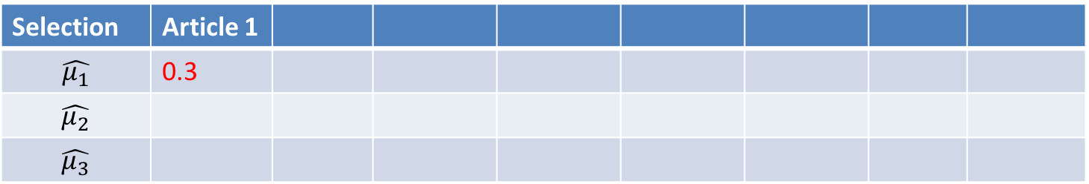
Exploitation VS. Exploration
$$μ_{1}=0.6$$
$$μ_{2}=0.4$$
$$μ_{3}=0.8$$
t
Selection | Article 1
$$\hat{μ_{1}}$$ | 0.3
$$\hat{μ_{2}}$$
$$\hat{μ_{3}}$$
Notes:
Since the reward distribution is unknown to the system and at the very beginning the system has no information about the articles. The system may randomly chose one arm to pull at the very beginning. For example at t=1, the system select article1 and got reward 0.3.

Slide 5
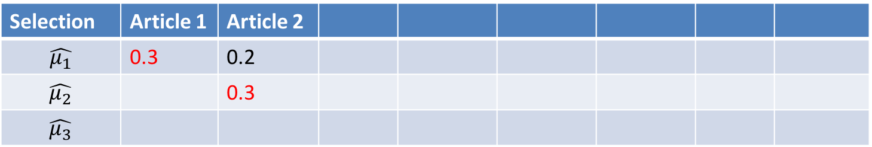
Exploitation VS. Exploration
$$μ_{1}=0.6$$
$$μ_{2}=0.4$$
$$μ_{3}=0.8$$
t
Selection | Article 1 | Article 2
$$\hat{μ_{1}}$$ | 0.3 | 0.2
$$\hat{μ_{2}}$$ |  | 0.3
$$\hat{μ_{3}}$$
Notes:
Since the reward distribution is unknown to the system and at the very beginning the system has no information about the articles. The system may randomly chose one arm to pull at the very beginning. For example at t=1, the system select article1 and got reward 0.3.
And at time t=2, let’s assume the system select article 2 and got reward 0.2.

Slide 6
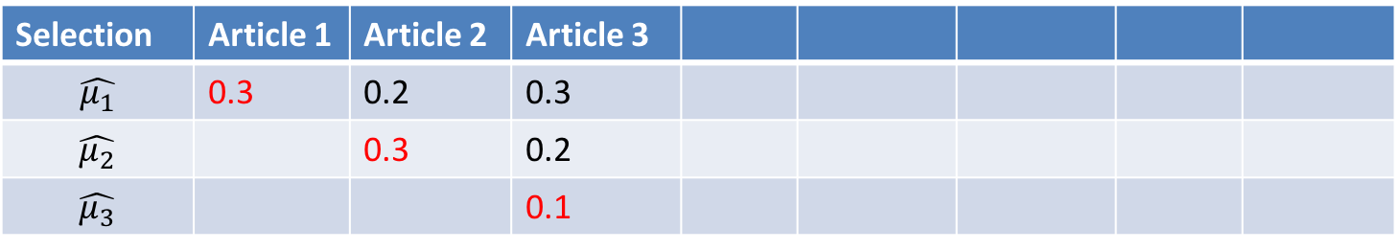
Exploitation VS. Exploration
$$μ_{1}=0.6$$
$$μ_{2}=0.4$$
$$μ_{3}=0.8$$
t
Selection | Article 1 | Article 2 | Article 3
$$\hat{μ_{1}}$$ | 0.3 | 0.2 | 0.3
$$\hat{μ_{2}}$$ |  | 0.3 | 0.2
$$\hat{μ_{3}}$$ |  |  | 0.1
Notes:
Since the reward distribution is unknown to the system and at the very beginning the system has no information about the articles. The system may randomly chose one arm to pull at the very beginning. For example at t=1, the system select article1 and got reward 0.3.
And at time t=2, let’s assume the system select article 2 and got reward 0.2.
And at time t=3, pull article 3, got reward 0.1

Slide 7

Exploitation VS. Exploration
$$μ_{1}=0.6$$
$$μ_{2}=0.4$$
$$μ_{3}=0.8$$
t
Selection | Article 1 | Article 2 | Article 3 | ?
$$\hat{μ_{1}}$$ | 0.3 | 0.2 | 0.3
$$\hat{μ_{2}}$$ |  | 0.3 | 0.2
$$\hat{μ_{3}}$$ |  |  | 0.1
Notes:
Since the reward distribution is unknown to the system and at the very beginning the system has no information about the articles. The system may randomly chose one arm to pull at the very beginning. For example at t=1, the system select article1 and got reward 0.3.
And at time t=2, let’s assume the system select article 2 and got reward 0.2.
And at time t=3, pull article 3, got reward 0.1
Then the system got an estimation of the expected reward from each article. Based on current reward estimation, which article should the system paly at time t =4?

Slide 8
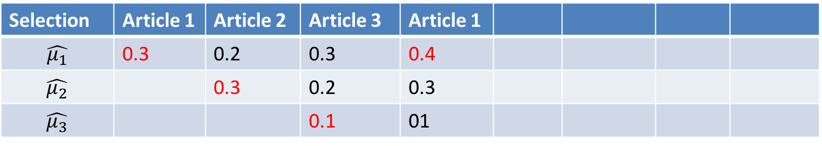
Exploitation VS. Exploration
$$μ_{1}=0.6$$
$$μ_{2}=0.4$$
$$μ_{3}=0.8$$
t
Selection | Article 1 | Article 2 | Article 3 | Article 1
$$\hat{μ_{1}}$$ | 0.3 | 0.2 | 0.3 | 0.4
$$\hat{μ_{2}}$$ |  | 0.3 | 0.2 | 0.3
$$\hat{μ_{3}}$$ |  |  | 0.1 | 01
Notes:
If the system does not explore, just stick to the article with highest estimated reward, it will pull article 1 (because based on the current estimation, arm 1 has the highest expected reward)

Slide 9
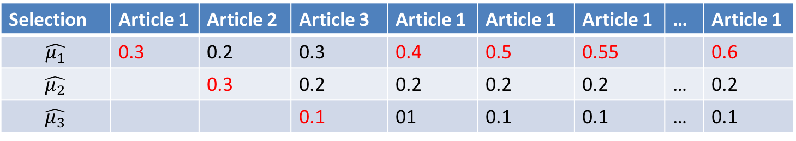
Exploitation VS. Exploration
Exploit too early and too much!
$$μ_{1}=0.6$$
$$μ_{2}=0.4$$
$$μ_{3}=0.8$$
t
Selection | Article 1 | Article 2 | Article 3 | Article 1 | Article 1 | Article 1 | … | Article 1
$$\hat{μ_{1}}$$ | 0.3 | 0.2 | 0.3 | 0.4 | 0.5 | 0.55 |  | 0.6
$$\hat{μ_{2}}$$ |  | 0.3 | 0.2 | 0.2 | 0.2 | 0.2 | … | 0.2
$$\hat{μ_{3}}$$ |  |  | 0.1 | 01 | 0.1 | 0.1 | … | 0.1
Notes:
Then if the system keep playing this way, we will get the following result:
The play will keep playing with arm 1 afterwards, which is obviously not the optimal choice to maximize the total accumulated reward.
In this example, because the system exploit too early and too much. That’s why we need to balance exploitation and exploration.

Slide 10
Running Example: News Recommendation
Multi-armed Bandit:
Player → Recommendation system
Arms → News articles (with side information)
Reward → User Click
Notes:
In fact, Multi-armed Bandit algorithm provide principled online learning solution to find optimal trade-offs between exploration and exploitation. Mapping multi-armed bandit problem the news recommendation example: the player in multi-armed bandit is the recommendation system, arms are the news articles, the reward is the user feedback.
Moreover, in recommendation system there is side information about the items or users available, which makes it a contextual bandits problem. In contextual bandit problems, the expected payoff is assumed to be determined by a conjecture of unknown bandit parameter and the given context.

Slide 11

A Collaborative Environment
Motivation:
Cold start problem in Personalized systems
Bandits are not independent
--Social influence among users:
e.g., content and opinion sharing among friends in social network
Solution:
Model dependency among users
Notes:
In a personalized recommendation system, each user is associated with a bandit parameter, which is often estimated independently.
However, one important problem in personalized systems with independence assumption is the cold start problem. For new users with only a few observation, it is hard to have a good estimation of the user’s preference.
Another important observation that motivated our work is that bandits/users are not independent, especially in recommendation systems . For example there is social influence among users: content and opinion sharing among friends in social network.
Motivated by this observation and the cold-start challenge, we introduce user relation information to model dependency among users in our developed contextual bandit algorithm, and also provide theoretical analysis of it .

Slide 12
Related work
Move this after page 9 to explain state-of-the-art bandit solution is contextual bandit
And do not name this slide as related work, you can refer to it as “state-of-the-art”
LinUCB^{[1,2]}:
--Use ridge regression and Upper Confidence Bound to balance exploitation and exploration.
--Bandits/users are independent.
Notes:
The most basic baseline of our developed model is LinUCB, which is one of the state-of-art method in contextual bandits. In LinUCB, ridge regression and Upper Confidence Bound(UCB) are used to balance exploitation and exploration. And bandits/users are assumed to be independent in LinUCB.

Slide 13
Related work
Create a figure to illustrate the idea, just like what you have in the next slide, show a social network and demonstrate how does network-based regularization work
GOB.Lin^{[5]}:
--Use ridge regression and Upper Confidence Bound to balance exploitation and exploration (as in LinUCB).
--Graph Laplacian based regularization upon ridge regression to model dependency.
--Similar users are assumed to share similar parameters.
Notes:
And there indeed exist some work that considered user dependency in contextual bandit, among which the most related with ours is GOB.Lin (from the paper ‘A Gang of Bandits’). GOB.Lin introduce graph Laplacian based regularization ridge regression to model dependency. It assume that similar users share similar parameters.

Slide 14
Related work
CLUB^{[4]}:
--Adaptively cluster users into groups according to the closeness of estimated bandit models
--Threshold to delete edges is based on confidence balls of the users’ models.
Notes:
Another work that is related to us is the Online Clustering of Bandits, called CLUB. In CLUB, users are adaptively clustered into groups according to the closeness of estimated bandit models. Users are assumed to be in one cluster at the very beginning. Then based on the confidence balls of each user model, edges are delete to form new clusters of users.

Slide 15
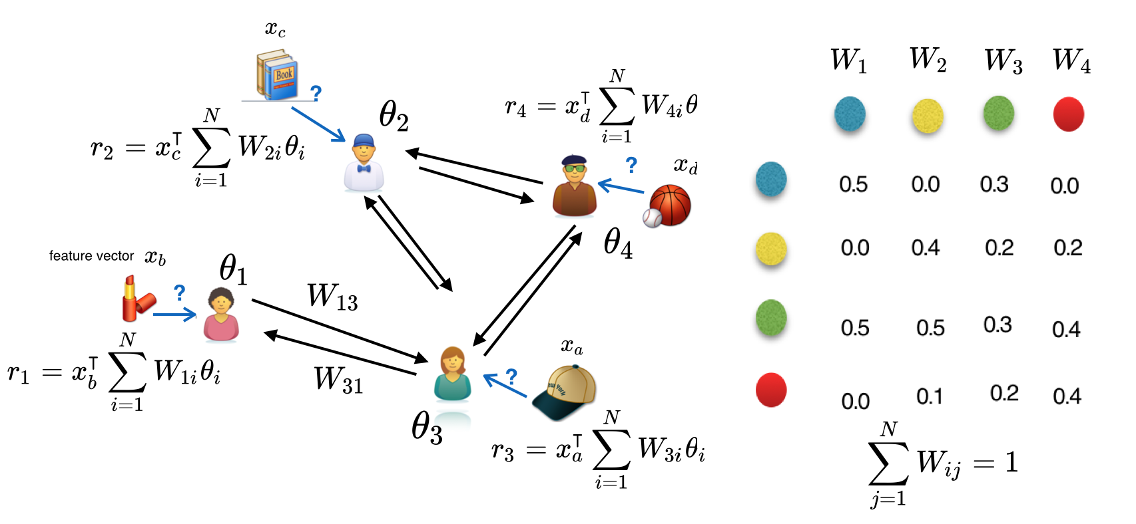
Model Assumption
A collaborative assumption:
R-sub-Gaussian
Move this slide after the next slide, which supposes to talk about context-free case
Notes:
In our developed model, the reward is assumed to be determined by a conjecture of the given context $x_{a}$ and the aggregation of the unknown bandit parameter $θ$. \epsilon_t is R-sub-Gaussian noise in the reward generation.
W is the relation matrix of users, \theta_i is the bandit parameter for user i.

Slide 16

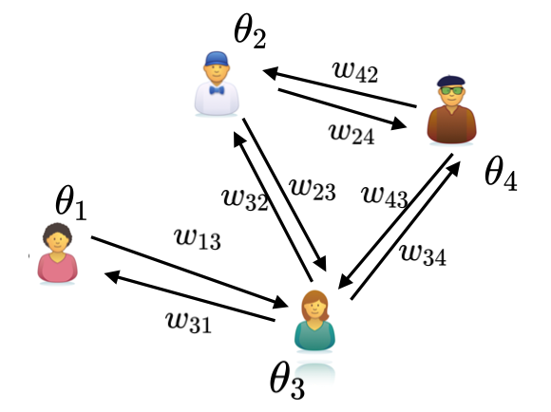
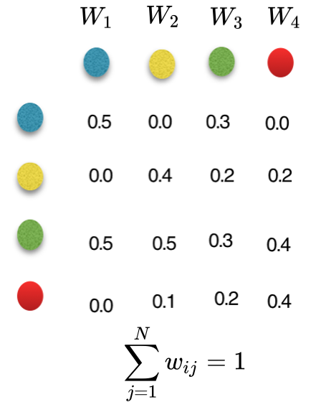
Model Assumption
Those icons stand for news article? Can you find better icons?
?
Here we do not need to make it contextual, just put the estimated reward is fine
Change those colored balls to user icons
Weighted average of expected reward
Notes:
Here I use another toy example to illustrate our model.
First we build an adjacency matrix W to encode the relations among users. Then weighted average of expected reward is computed to help making recommendations. For example, in estimating users’ preference to the stock news, not only this users’ opinion is considered but also all the other users that is related with him/her.

Slide 17



Model Assumption
I guess you misunderstood my point: using the reward symbol in the previous slide, and use context vector in this slide, since only context vector helps us generalize across arms
Notes:
Similarly, opinion sharing can be extended to different items because of the context information. This in fact can help solve the data sparsity issue because of the opinion propagation, observations can be reused.
In addition, the collaborative model can in fact be extended to a much more generalized setting, including not only contextual bandit but also non-contextual cases.

Slide 18
Exploitation
Objective Function:
Parameter Estimation: Ridge Regression
Information Propagation among users through relational matrix W
Notes:
For the exploitation part, we apply ridge regression to do parameter estimation as follows:
Note that the effect of collaboration can be clearly seen from the design matrix A and the response vector b: the information propagation among users through relational matrix W.

Slide 19
Exploration
UCB-type exploration strategy
Every iteration:
Upper Confidence Bound
Estimated reward
(exploitation)
Confidence interval
(exploration)
Notes:
For the exploration part, UCB(Upper confidence bound)-type of exploration strategy is applied here:
In every iteration, arm is selected base on both the current estimated reward, which reflects exploitation, and the confidence interval of the estimation, which reflects exploration.

Slide 20
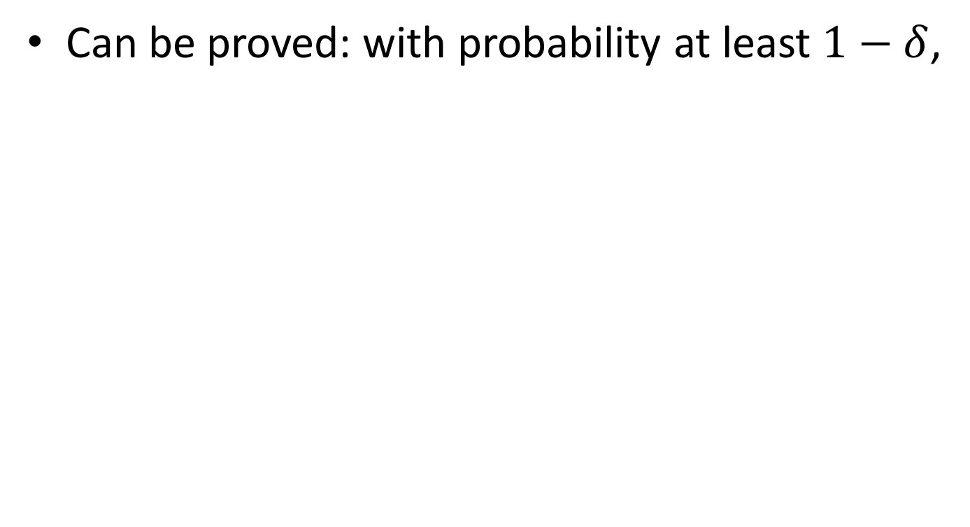
Exploration
Can be proved: with probability at least $1−δ$,
Exploration parameter (upper bound of parameter estimation error)
Notes:
In our developed model (CoLin), it can be proved that the reward estimation error can be bounded with probability at least 1-\delta by the shown term. This conclusion gives us a tight bound of the confidence interval for exploration. \alpha_t is the exploration parameter.

Slide 21
Arm selection strategy
Exploitation vs. Exploration
Exploitation
Exploration
Notes:
Then combining both exploitation and exploration, we got a UCB-type arm selection strategy as follows.

Slide 22
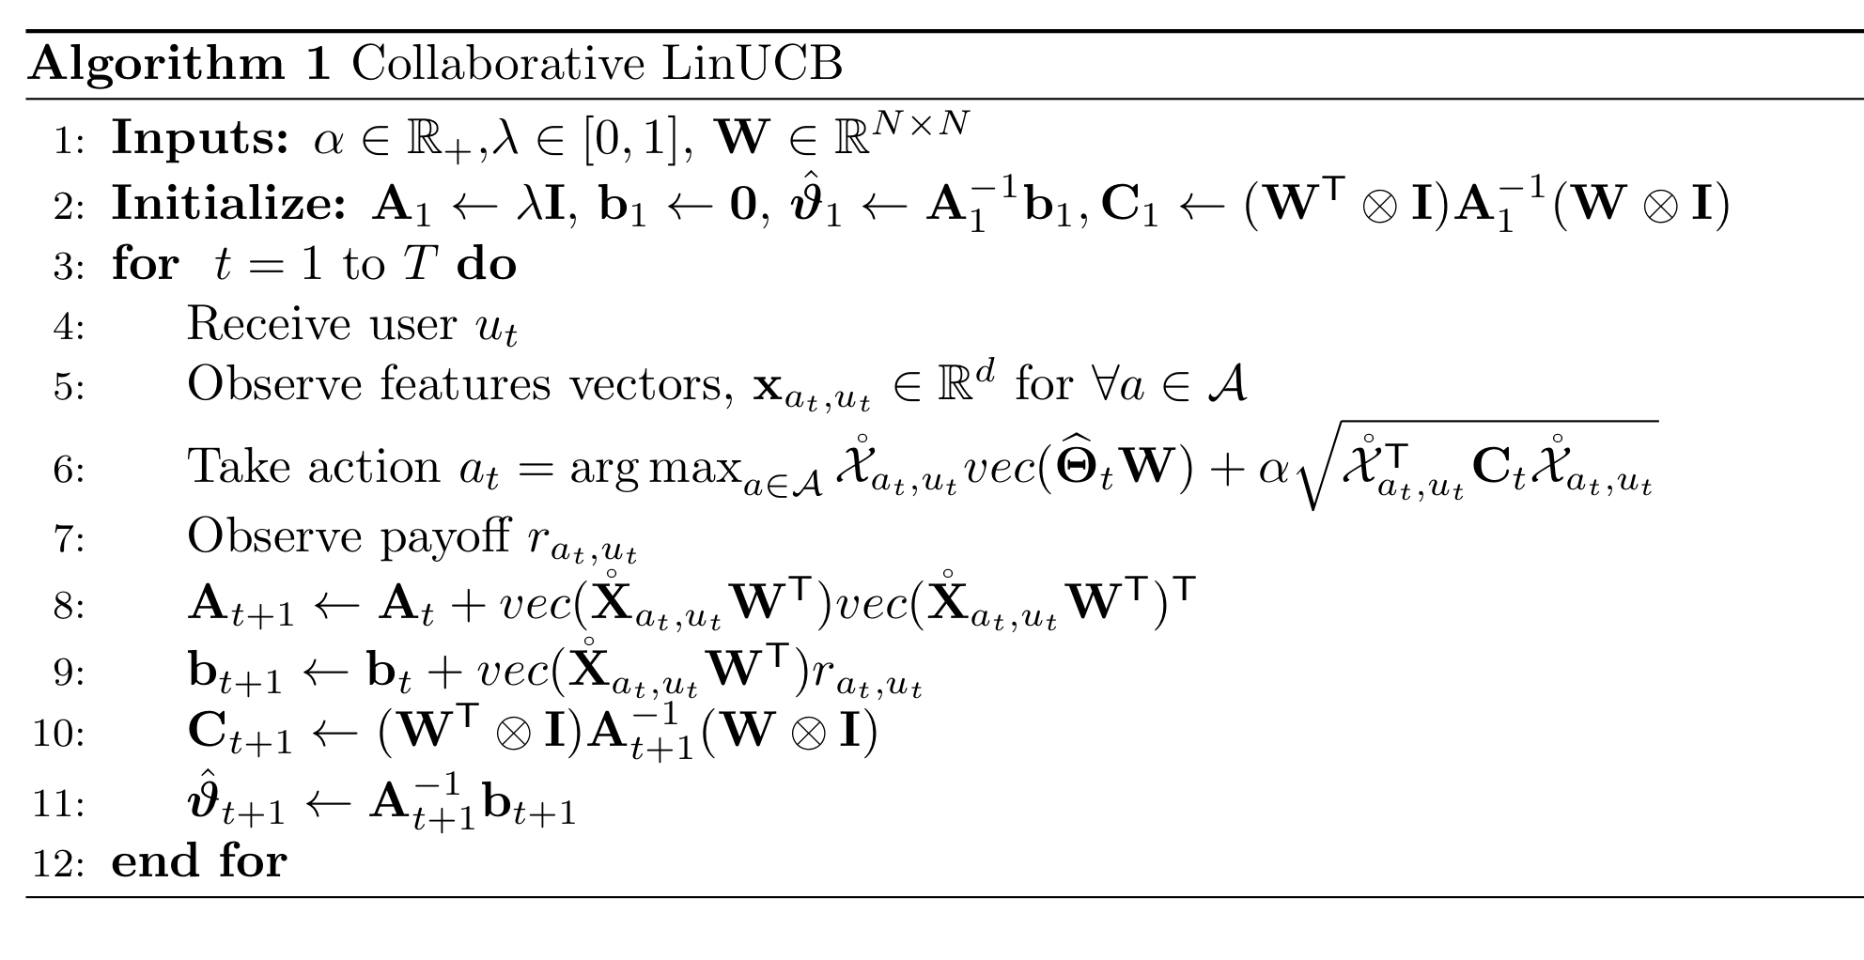
Algorithm-CoLin
Notes:
And here is the details of our developed algorithm—Collaborative LinUCB or CoLin in short.
After receiving user and observing the feature vectors of all candidate articles, the algorithm select articles based on our designed arm selection strategy. Model parameters will be updated once feedback is observed. Note that because of the rank one update of matrix A, matrix inversion can be avoided through rank one correction by applying Sherman–Morrison formula.

Slide 23
Regret Analysis
Regret is not your optimization target, but one typical performance metric
Regret: optimization target
Received reward
Cumulated regret
Regret at time t
Optimal reward
Notes:
Then let’s go through some theoretical analysis of our developed algorithm CoLin.
First of all, one important theoretical concept of contextual bandit is ‘regret’. Regret at time t is defined as the difference between optimal reward and the received reward. In multi-armed bandit problems, regret gives a theoretical guarantee of how good or how bad the algorithm is.

Slide 24
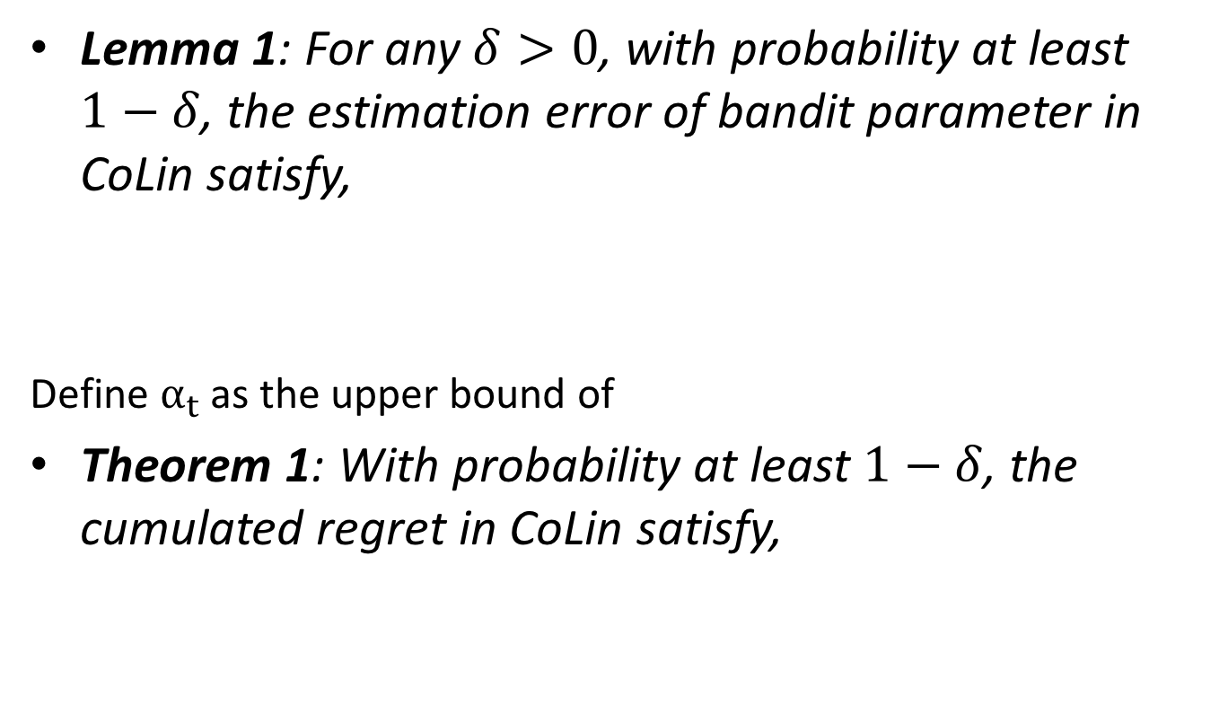
Regret Analysis
Lemma 1: For any $δ>0$, with probability at least $1−δ$, the estimation error of bandit parameter in CoLin satisfy,
Define $α_{t}$ as the upper bound of
Theorem 1: With probability at least $1−δ$, the cumulated regret in CoLin satisfy,
Notes:
For our developed algorithm, lemma 1 gives a conclusion of the estimation error of the bandit parameters in CoLin, which as we mentioned before, will serve as the exploration parameter in our developed arm selection strategy.
And theorem 1 gives a upper bound of the accumulated regret.
We can clearly see that the structure of W, i.e., the relational matrix of users, plays an important role in both lemma 1 and Theorem 1.

Slide 25
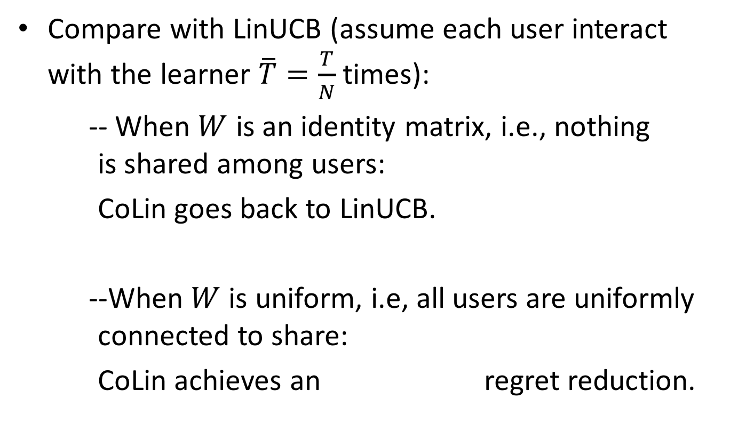
Regret Analysis
Compare with LinUCB (assume each user interact with the learner $\overline{T}=\frac{T}{N}$ times):
-- When $W$ is an identity matrix, i.e., nothing is shared among users:
CoLin goes back to LinUCB.
--When $W$ is uniform, i.e, all users are uniformly connected to share:
CoLin achieves an regret reduction.
Notes:
In order to better understand the theoretical advantage of our developed model, here we compare the regret bound of CoLin with its two competitors: LinUCB and GOB.Lin, which have been introduced in the related work.
For the comparison with LinUCB, we look at two extreme cases to see how W plays a role here:
(1). When W is identity matrix, i.e., nothing is shared among users, then the regret bound is O(N lnT \sqrt T): CoLin goes back to LinUCB as expected.
(2). When W is uniform, i.e., all users are uniformly connected to share, the regret bound is O(N ln T/N \sqrt T). In this case CoLin achieves an O(ln N \sqrt T) regret reduction.

Slide 26
Regret Analysis
Compare with GOB.Lin:
GOB.Lin :
--Use graph Laplacian based model regularization to model dependency.
-- Assumes the neighboring bandit parameters to be close to each other
-- Only capture connectivity of the network
Bring back the illustration for GOB.Lin in slide 12 to remind the audience what this baseline is
Notes:
For the comparision with GOB.Lin:
GOB.Lin
-- Use graph Laplacian based model regularization to model dependency.
-- Assumes the neighboring bandit parameters to be close to each other
-- Only capture connectivity of the network

Slide 27
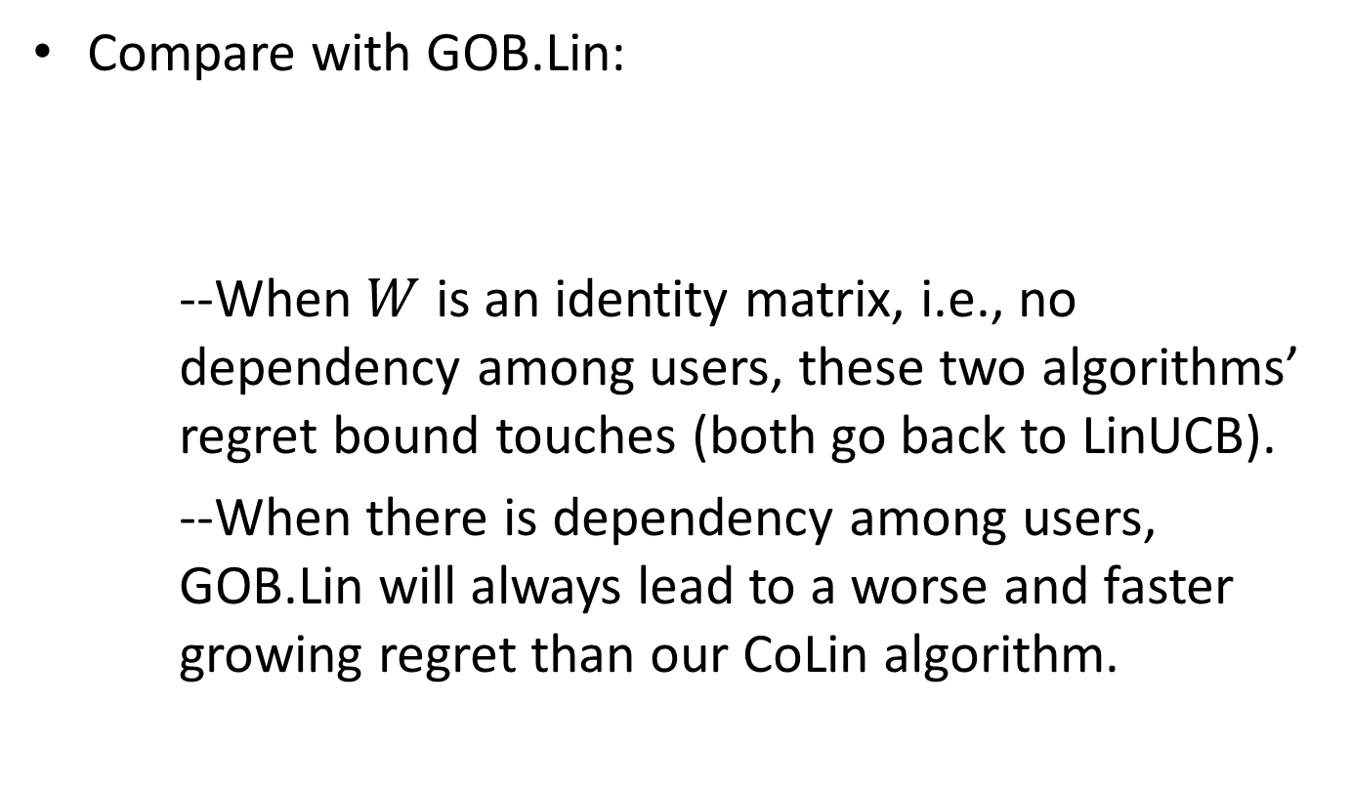
Regret Analysis
Compare with GOB.Lin:
--When $W$ is an identity matrix, i.e., no dependency among users, these two algorithms’ regret bound touches (both go back to LinUCB).
--When there is dependency among users, GOB.Lin will always lead to a worse and faster growing regret than our CoLin algorithm.
Notes:
Here R_G represents the regret bound of GOB.Lin and R_C represents the regret bound of CoLin.
Then from the resulting regret difference of GOB.Lin and CoLin, we can see that:
When $W$ is an identity matrix, i.e., no dependency among users, these two algorithms’ regret bound touches (both go back to LinUCB).
While when there is dependency among users, GOB.Lin will always lead to a worse and faster growing regret than our CoLin algorithm.

Slide 28
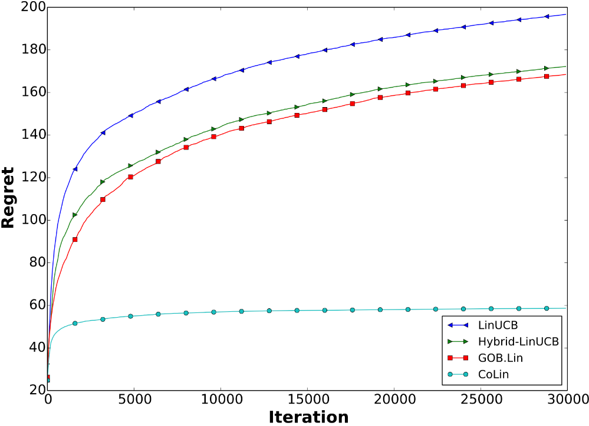
Experimental Results
Synthetic Dataset
Simulated 1000 articles, 100 users, each with a 5-dimensional feature vector
W is constructed based on the cosine similarity of user features
CoLin
Convergence of cumulated regret
Notes:
Then let’s take a look at some experimental results of our developed model.
First we tested our model and its competitors on a synthetic dataset:
In this experiment, we simulated 1000 articles, 100 users, each with a 5-dimensional feature vector. And W is constructed based on the cosine similarity of user features.
We simulated the reward generation process according to our model assumption.
This figure shows the regret of different algorithm in this simulated environment. The huge gap between CoLin and its competitors shows the advantage of modeling the dependency among users.

Slide 29
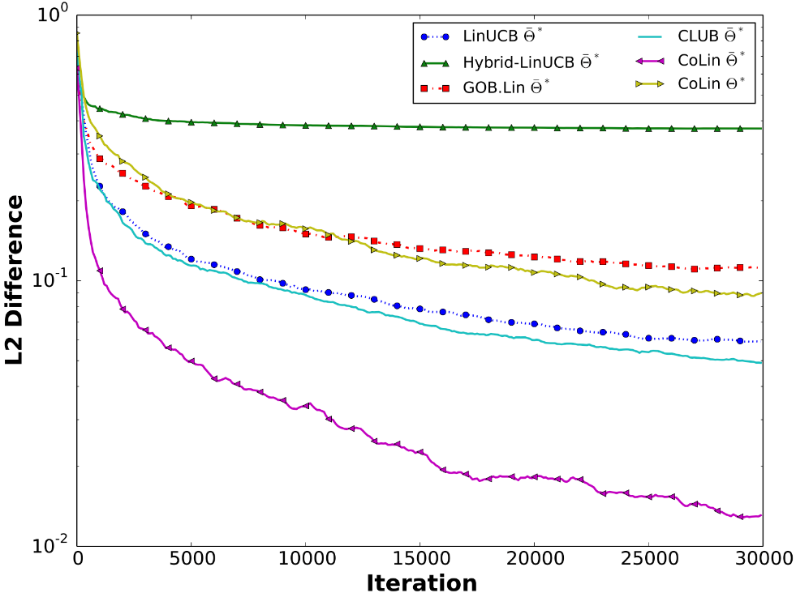
Experimental Results
Synthetic Dataset
Accuracy of bandit parameter estimation
Simulated 1000 articles, 100 users, each with a 5-dimensional feature vector
W is constructed based on the cosine similarity of user features
CoLin
CoLin
Notes:
This figure shows the accuracy of bandit parameter estimation:
Including the bandit parameter after collaboration \bar Theta
And also the learnt bandit parameter for each individual users \Theta.

Slide 30
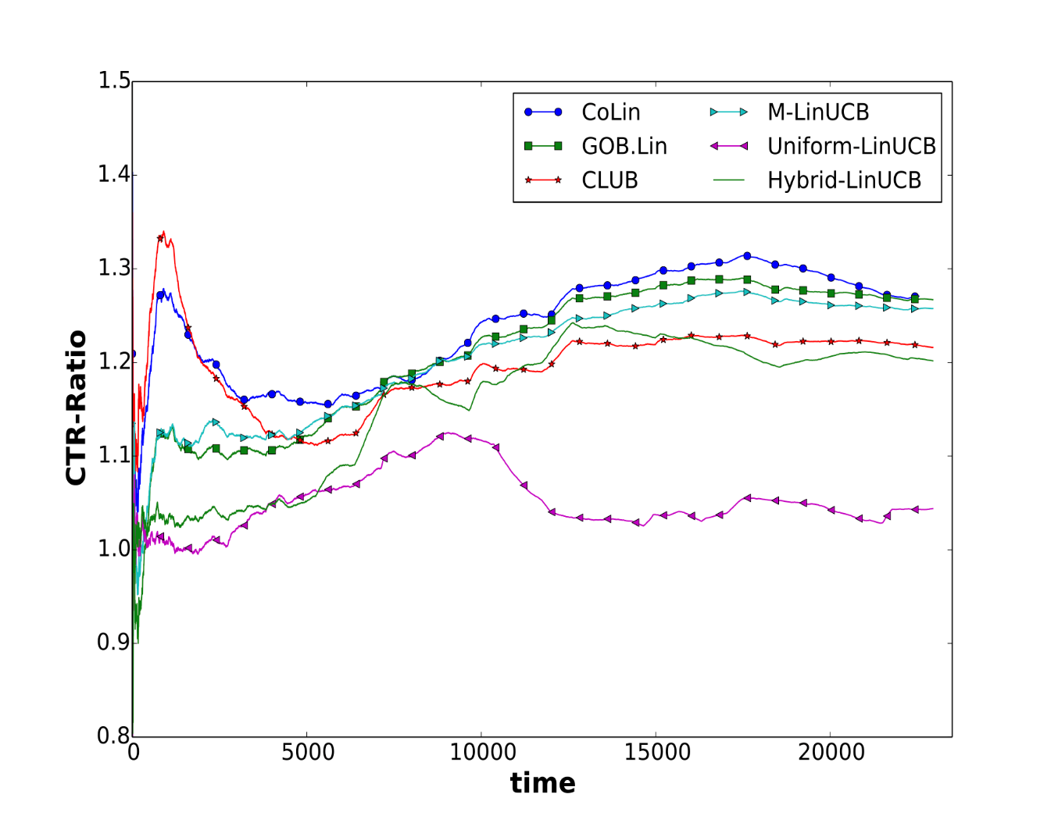
Experimental Results
Yahoo! Today Module
Normalized CTR on Yahoo dataset
10 days data from Yahoo! Today Module
45,811,833 user visits
Users are clustered into 160 groups
User relation matrix is constructed according to the similarity of centroids of user groups
CoLin
Notes:
We also tested the algorithms on a real-world dataset from Yahoo! Today Module.
This dataset include 10 days data from Yahoo! Today Module, which includes 45,811,833 user visits. In order to make it more efficient, users are clustered into 160 groups according to the closeness of user features. And user relation matrix is constructed according to the similarity of centroids of user groups. This figure shows the normalized Click-Through-Rate of the all the comparing algorithms. CTR is normalized by a random algorithm.

Slide 31
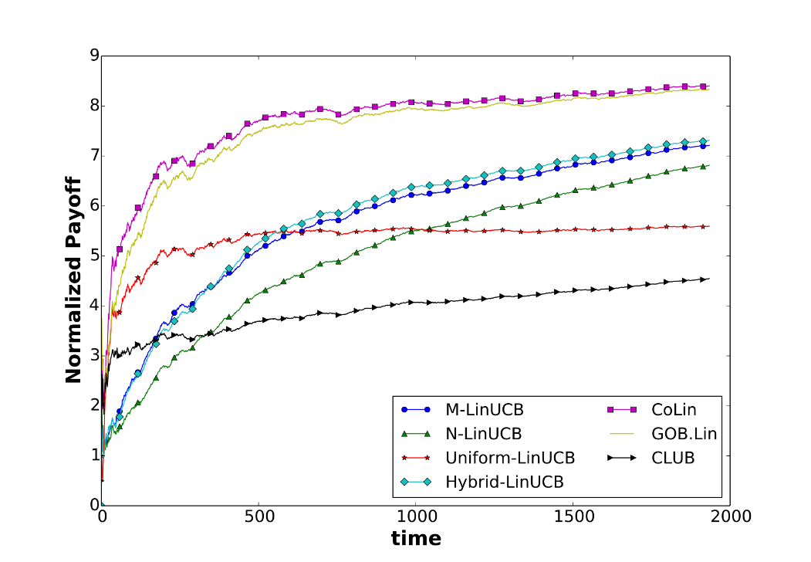
Experimental Results
LastFM & Delicious
LasfFM: Extracted from music steaming service Last.fm
Delicious: Extracted from social bookmark sharing service Delicious
Both contain user friendship information(around 2000 users)
Users are clustered into groups(200) using graph-cut
CoLin
LastFM Dataset
Notes:
We also tested the algorithms on another two real-world datasets: Last.fm and delicious.
LastFm is a dataset extracted from the music steaming service last.fm.
Delicious is a dataset extracted from the social bookmark sharing service Delicious
Both LastFM and Delicious contain user friendship information (for around 2000 users ). And users are clustered into groups (200 groups) using graph-cut.
This figure shows the normalized payoff of all the algorithms on LastFM.

Slide 32
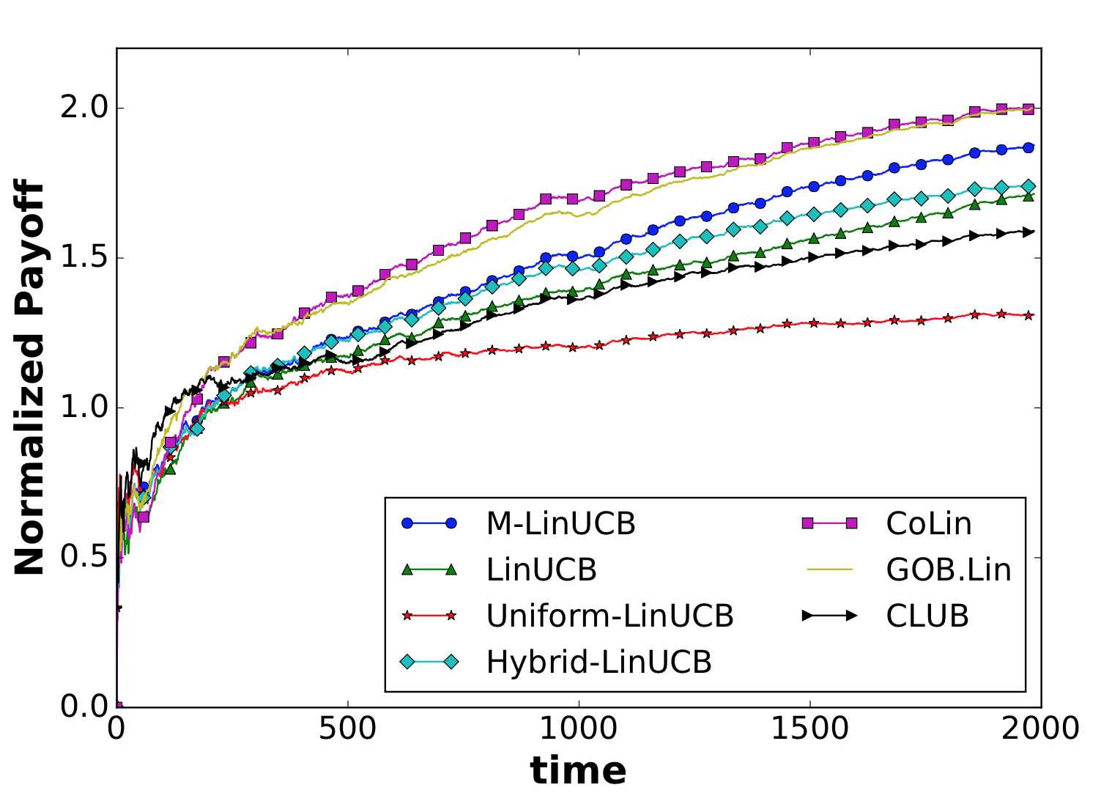
Experimental Results
LastFM & Delicious
LasfFM: Extracted from music steaming service Last.fm
Delicious: Extracted from social bookmark sharing service Delicious
Both contain user friendship information(around 2000 users)
Users are clustered into groups(200) using graph-cut
Delicious Dataset
CoLin
Notes:
And this figure shows the normalized payoff of all the algorithms on Delicious. From the results we can see that CoLin have a performance lift on both of the two datasets.

Slide 33
Experimental Results
Effectiveness of Collaboration
Rank user clusters by number of observations
Group 1 ( Learning Bucket ): Top 50 user clusters
Group 2 ( Testing Bucket ): The 50 user clusters that are most connected to users in Group 1, among the bottom 100 clusters
Warm-Start Setting:
--1. Run algorithms on the learning bucket to estimate parameters for both group of users.
--2.run and evaluate algorithms on the testing bucket.
Cold-Start Setting:
--Directly run and evaluate the bandit algorithms on the testing bucket.
Notes:
In addition, we also did an interesting experiment on LastFM and Delicious to further test the effectiveness of collaboration.
We first rank user clusters by number of observations and put the top 50 users clusters in Group1, which is the learning bucket. And in group 2, there are 50 user clusters which are the most connected the users in group 1 among the bottom 100 clusters.
And we have two settings of experiment: a warm-start setting and a cold-start setting.
In the warm-start setting: we first run algorithms on the learning bucket to estimate parameters for both group of users. Then run and evaluate algorithms on the testing bucket.
In the cold-start setting, we directly run and evaluate the bandit algorithms on the testing bucket.
In the warm-start setting, because user group 2 does not have any observation in the learning bucket, their model parameters can only be updated via collaboration among bandits, i.e., in CoLin and GOB- Lin.

Slide 34
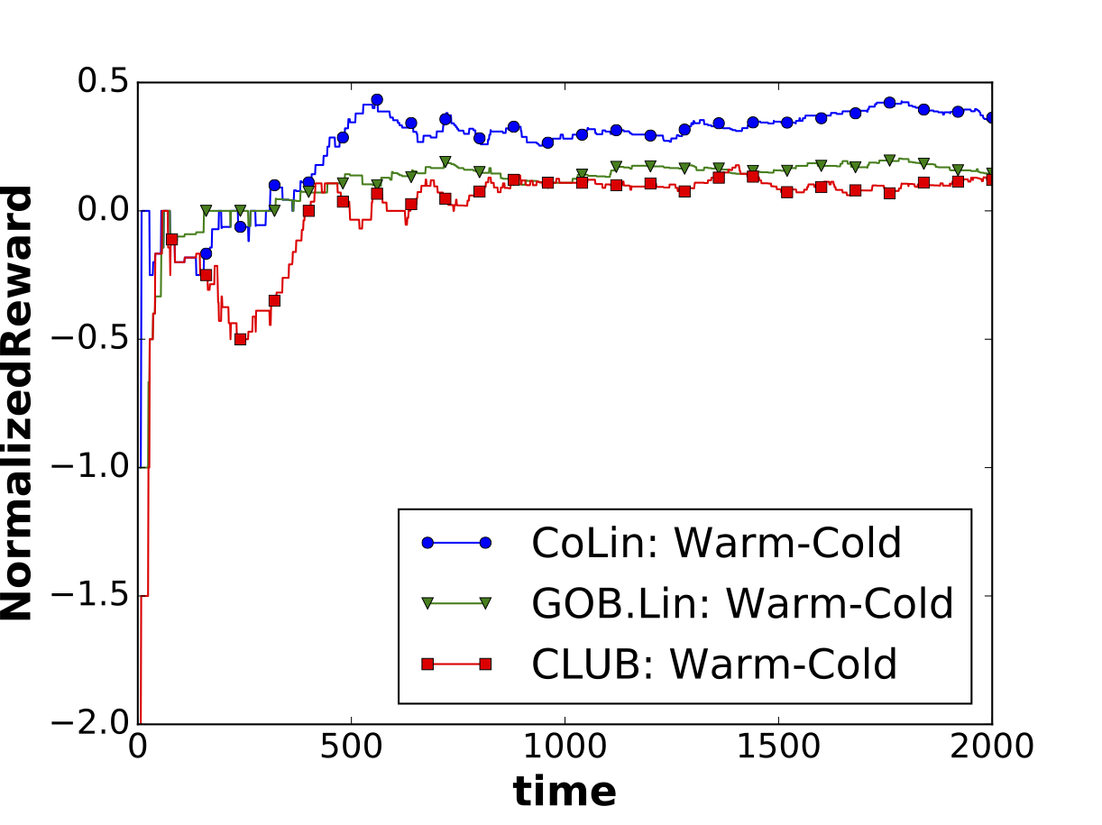
Experimental Results
Effectiveness of Collaboration
Compare the reward difference between Warm-Start setting and Cold-Start setting: (warm-cold)
In LinUCB, (warm- cold) is always 0 (No collaboration)
LastFM Dataset
CoLin
Notes:
In this figure we compare the reward difference between Warm-Start setting and Cold-Start setting: (warm-cold) on LastFM.
As we expected, sine there is no collaboration among users, the reward difference(warm - cold) in LinUCB is always 0. And the difference in CoLin is the largest, which shows the great benefits of collaboration in CoLin. This verified CoLin’s effectiveness in address the cold- start challenge.

Slide 35
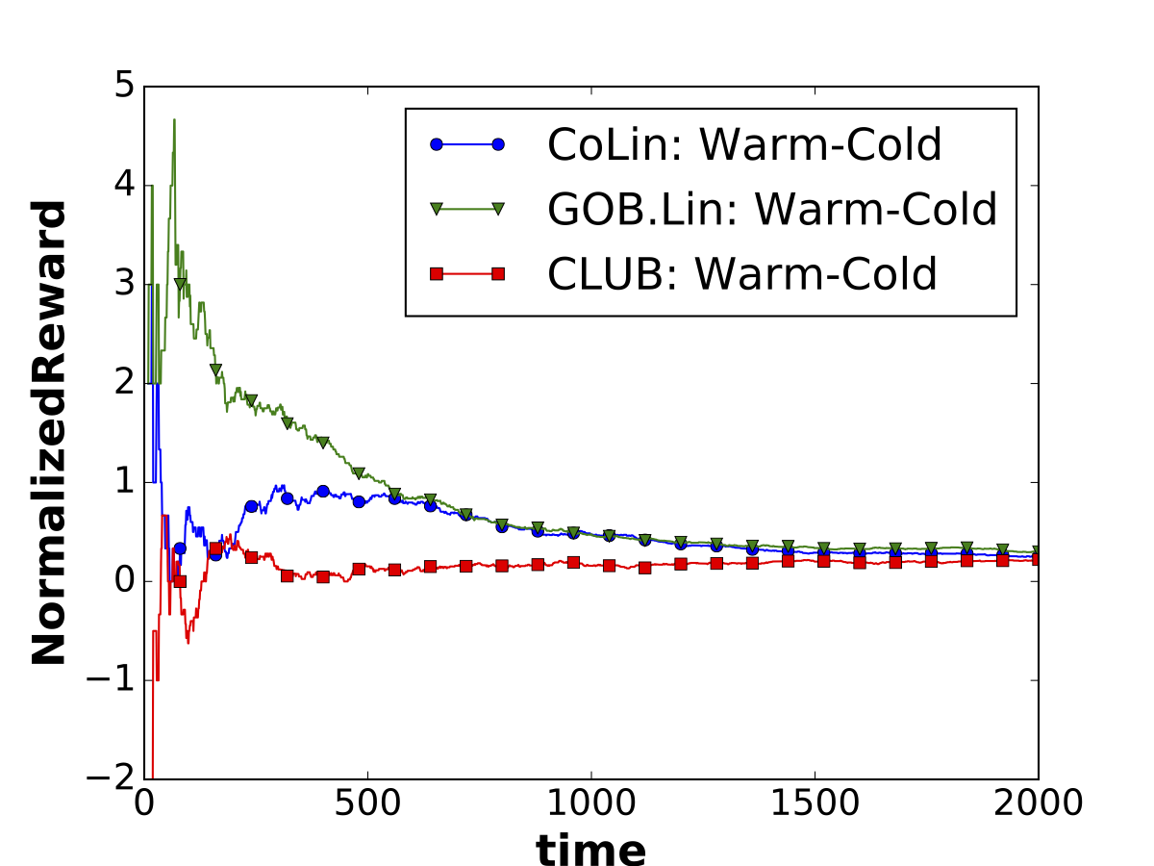
Experimental Results
Effectiveness of Collaboration
Delicious Dataset
Compare the reward difference between Warm-Start setting and Cold-Start setting: (warm-cold)
In LinUCB, (warm- cold) is always 0 (No collaboration)
CoLin
Notes:
On the Delicious dataset, we should note that the larger gap from GOB.Lin than that from CoLin between warm-start and cold-start settings does not mean CoLin is worse than GOB.Lin; but it indicates the cold-start CoLin learned faster than the cold-start GOB.Lin on this data set. And the final performance of both cold-start and warm-start CoLin was better than GOB.Lin in the corresponding settings.
We can also notice that cold-start CLUB performed very similarly as warm-start CLUB on both of the two datasets. It means the user clusters automatically constructed in CLUB does not help collaborative learning.

Slide 36
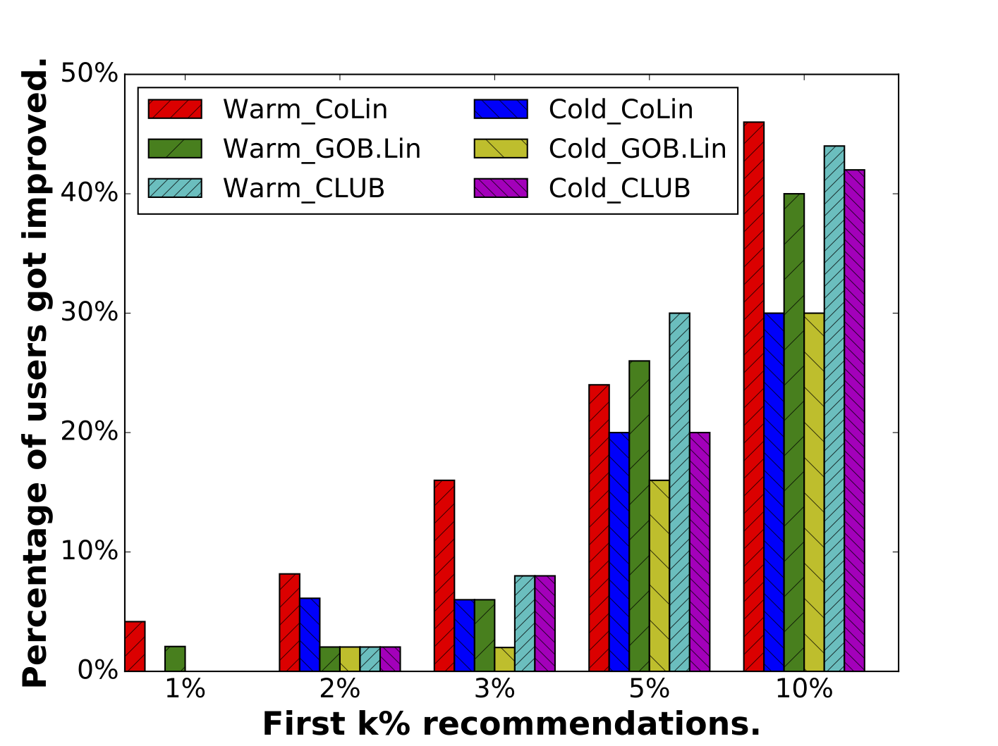
Experimental Results
Effectiveness of collaboration: User-based Analysis
Delicious Dataset
Improved user: the user who is served with improved recommendations from a collaborative bandit algorithm than those from isolated LinUCBs.
Notes:
In addition, to examine how many users will benefit from the collaborative bandits. We define an improved user as the user who is served with improved recommendations from a collaborative bandit algorithm (i.e. CoL- in, GOB.Lin and CLUB) than those from isolated LinUCBs. We report the percentage of improved users in the first 1%, 2%, 3%, 5%, and 10% observations during online learning. The figure demonstrate that on all collaborative bandit algorithms, the warm- start setting benefits much more users than cold-start setting.

Slide 37
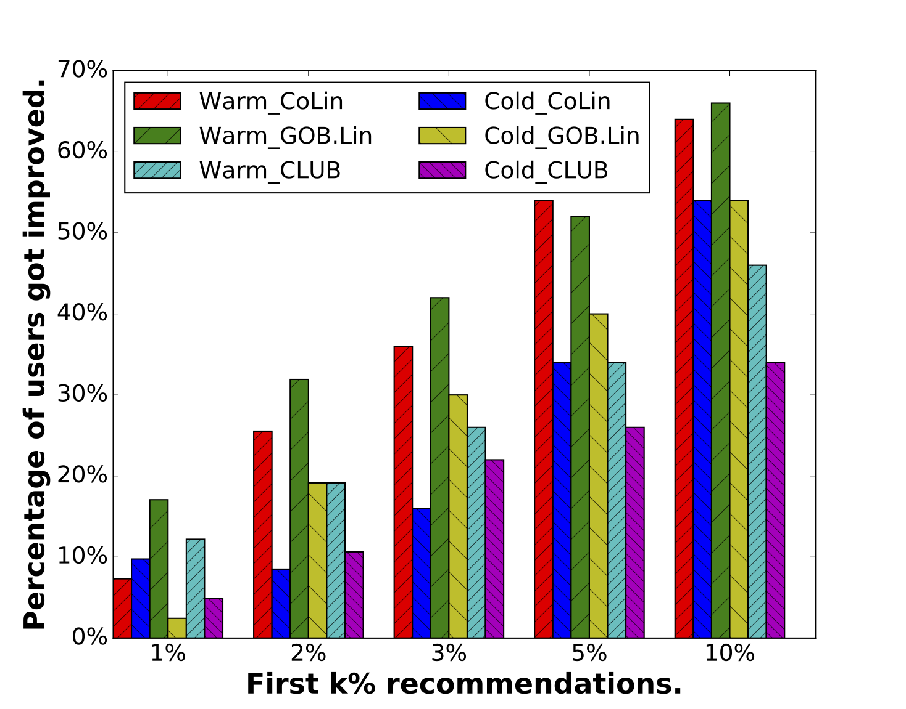
Experimental Results
Effectiveness of collaboration: User-based Analysis
LastFM Dataset
Improved user: the user who is served with improved recommendations from a collaborative bandit algorithm than those from isolated LinUCBs.
Notes:
To examine how many users will benefit from the collaborative bandits. We define an improved user as the user who is served with improved recommendations from a collaborative bandit algorithm (i.e. CoL- in, GOB.Lin and CLUB) than those from isolated LinUCBs. We report the percentage of improved users in the first 1%, 2%, 3%, 5%, and 10% observations during online learning. The figure demonstrate that on all collaborative bandit algorithms, the warm- start setting benefits much more users than cold-start setting.

Slide 38
Future Work
Dynamically estimate the graph structure in the collaborative bandits setting
Decentralize the computation by utilizing the sparse graph structure
Notes:
In our current setting, we have assumed the graph structure among users is known to the algorithm beforehand.
It is meaningful to study how to dynamically estimate the graph structure during online update with provable regret bound.
The computation complexity in CoLin is now expensive. Utilizing the sparse graph structure to decentralize the computation is an important and interesting research direction.

Slide 39
Acknowledgement
Thank the conference for awarding the travel grant
Thank the NSF grant IIS-1553568 for supporting this work
Notes:
Thank the conference for awarding the travel grant
Thank the NSF grant IIS-1553568 for supporting this work

Slide 40
References
[1]. L. Li, W. Chu,J. Langford, and R. E. Schapire. A contextual-bandit approach to personalized news article recommendation. In Proceedings of 19th WWW, pages 661–670. ACM, 2010.
[2]. W. Chu, L. Li, L. Reyzin, and R. E. Schapire. Contextual bandits with linear payoff functions. In International Conference on Artificial Intelligence and Statistics, pages 208–214, 2011.
[3]. Y. Abbasi-yadkori, D.Pál, and C. Szepesvári. Improved algorithms for linear stochastic bandits. In NIPS, pages 2312–2320. 2011.
[4]. C. Gentile, S. Li, and G. Zappella. Online clustering of bandits. In
Proceedings of the 31st International Conference on Machine Learning, 2014
[5]. N. Cesa-Bianchi, C. Gentile,and G. Zappella. A gang of bandits. In Pro. NIPS, 2013.
[6]. J. Kawale, H. H. Bui, B. Kveton, L. Tran-Thanh, and S. Chawla. Efficient Thompson sampling for online matrix-factorization recommendation. In NIPS, pages 1297–1305, 2015.

Slide 41

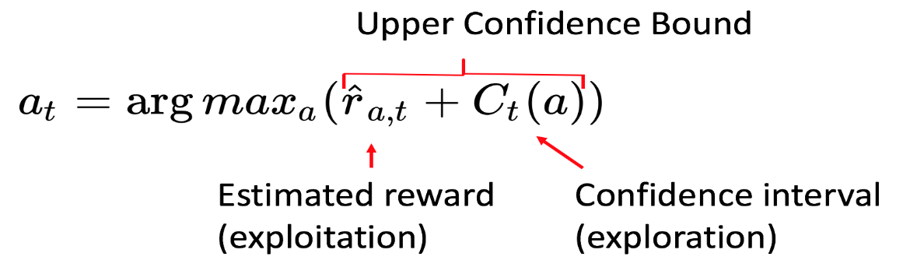

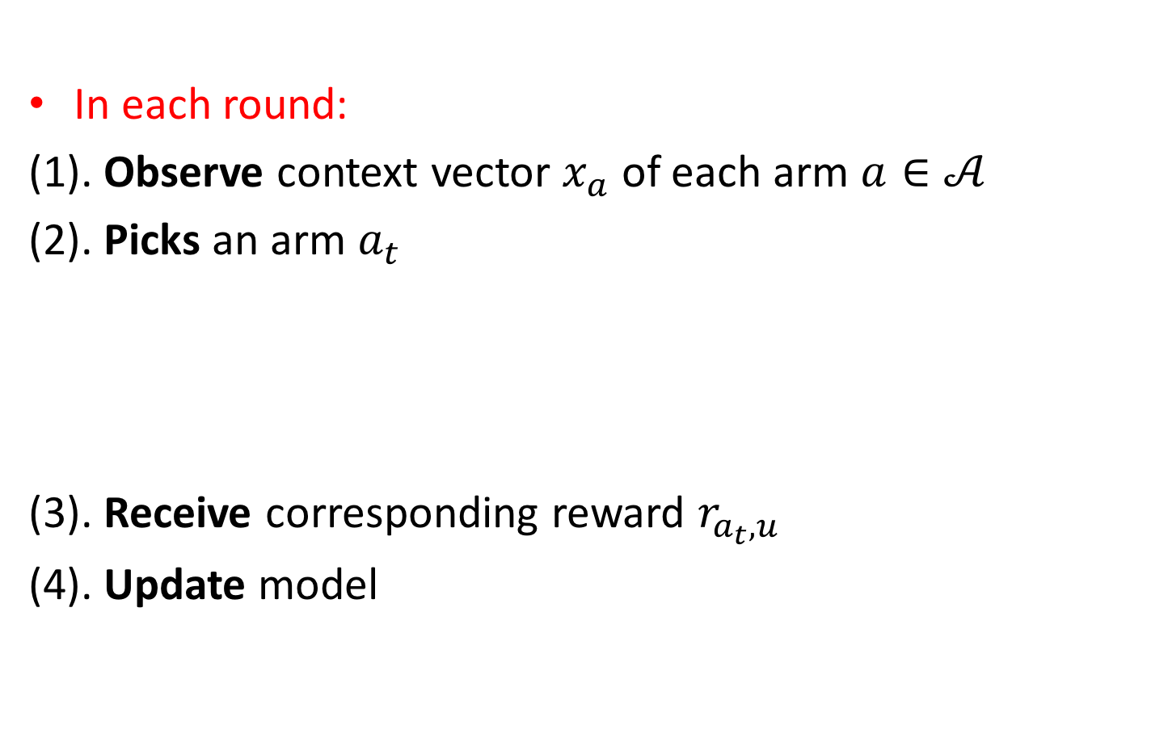
Contextual Bandits
In each round:
(1). Observe context vector $x_{a}$ of each arm $a∈𝒜$
(2). Picks an arm $a_{t}$
(3). Receive corresponding reward $r_{a_{t},u}$
(4). Update model
…
or

